Slide 1

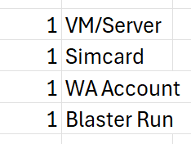
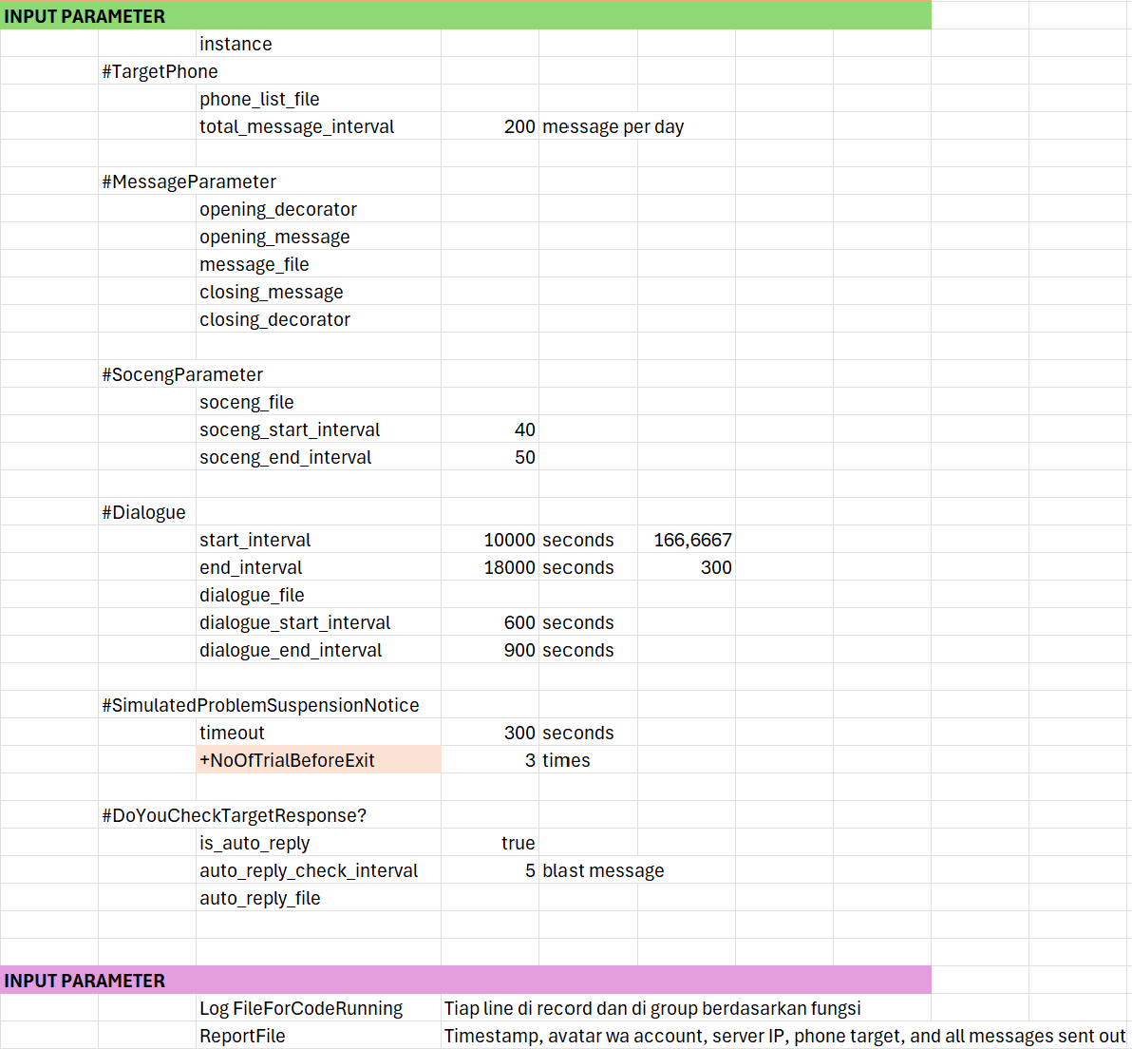
Independent WA Blaster

Slide 2




Blaster Sample Run
blast
soceng
soceng
soceng
dialog
1 min

Slide 3


Scalable Architecture
Phones
Message

